Slide 1
Identification of new air travel routes in emerging markets

Slide 2



Our team
Karthik Arunkumar
Bhagyashree Gohiya
Software Engineer
Analyst – Software Engineer
Udatha Venu
Senior Software Engineer

Slide 3
Agenda
Introduction
6
Problem Statement
7
Solution
10
Summary
11
Data Visualization
16

Slide 4




TOOLS AND TECHNOLOGIES

Slide 5

ETL PIPELINE
Dataset is taken from Kaggle
Scrapped data is now extracted, transformed and made ready for visualization using Jupyter and Databricks
The Transformed Data is Visualized for the further analysis

Slide 6
Introduction
3
To identify new route opportunities in the emerging markets by tracking macro-economic activities and data from other means of transport. The focus is on tier II cities from India. Aviation sector is showcasing intriguing growth rate in the emerging economies like India and other APAC nations. Due to various government initiatives, new aviation infrastructure is being developed in India. There is a push to provide affordable air travel for wider population. In addition, the economic growth of India is leading to distribution of economic activities across tier-II cities, which wasn’t necessarily the case in the recent past.

Slide 7
Problem Statement

Slide 8
Problem Statement
3
To forecast new air- travel routes in emerging Tier-II cites for faster and more profits to the economy. By this we might connect with across tier-II cities and between metro / tier-I cities.

Slide 9
Solution

Slide 10
Solution
3
We will analyze the Marco – Economy, Tourism, Companies in India and Market Research of Tier 1 cities and will be compared them with the Tier 2 cities. By this, we will conclude where Tier 2 cities lag and what needs to be improved to increase the air travel routes.

Slide 11
Summary

Slide 12
Datasets have been downloaded from Kaggle Dataset link --->> International Airtraffic to and from India ---->> Private and Public Sectors in India ---->> Tourism in India
Data Scrapping

Slide 13
Data Transformation
Here the datasets are being cleaned.
Applying the required filter conditions on the datasets.
Making the datasets ready for visualization.

Slide 14
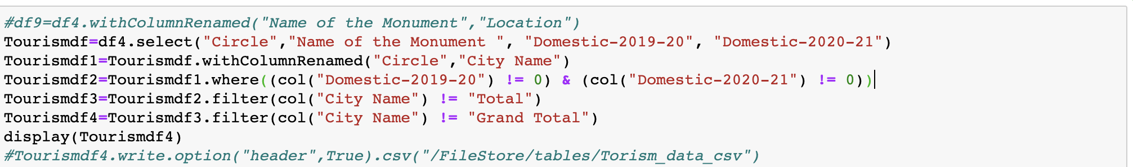
Data Transformation
Here are the code snippets of transformation

Slide 15
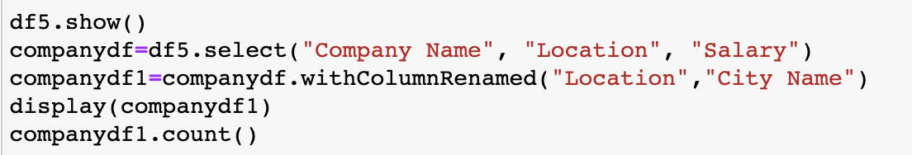

Slide 16
Data Visualization

Slide 17
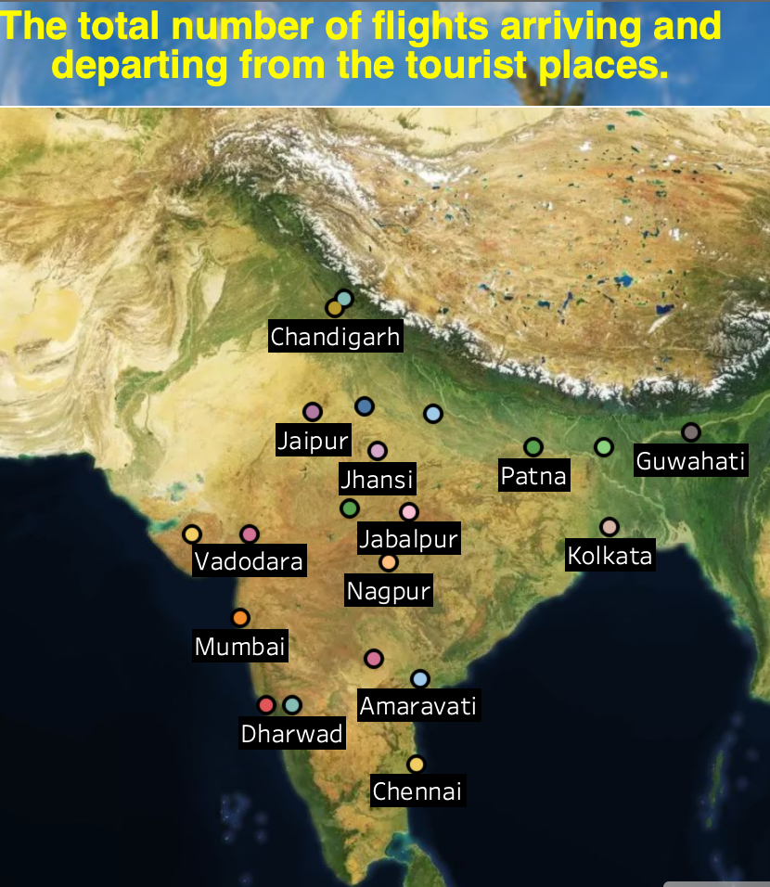
Data Visualization
Tourism plays an important role in a city's economy.
It is evident that there are some tourist places in tier-II cities like: Vadodara, Indore, Jaipur etc.
But people prefer to visit Tier-I since the mode of transport is highly available and easy commuting.

Slide 18
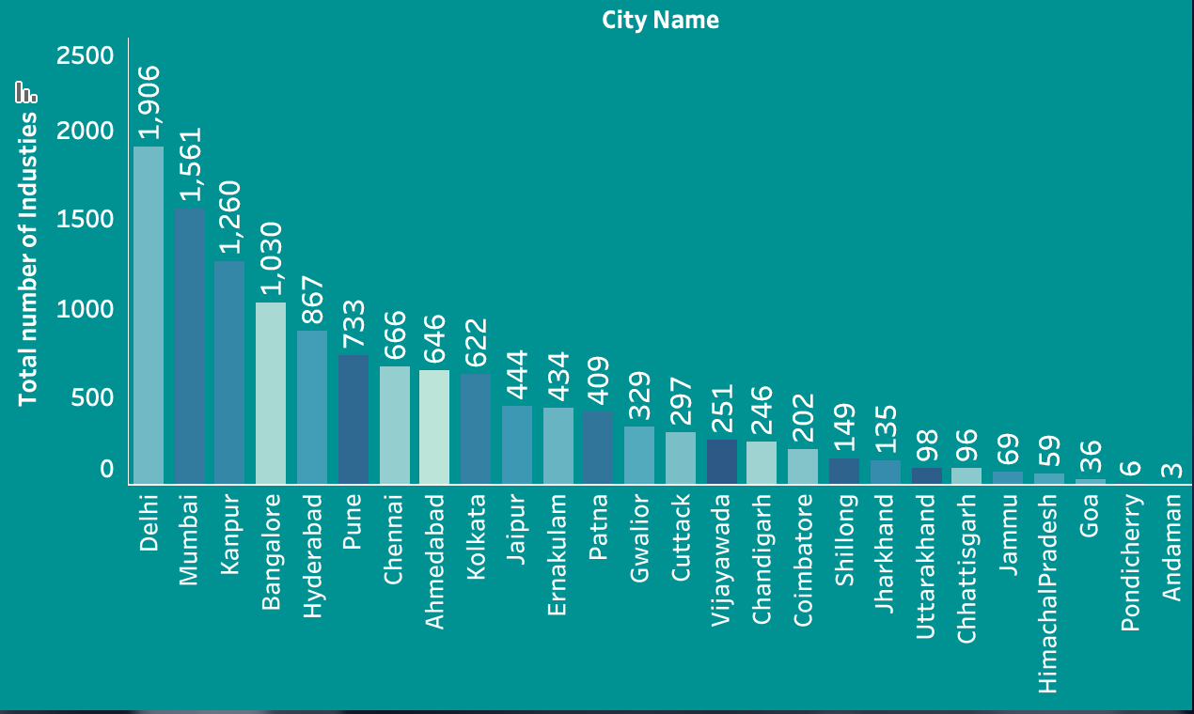
Industries in India
From the visualization we can say, Delhi has more industries and Andaman has the least, This might be the major factor why people's population is lesser in tier-II

Slide 19
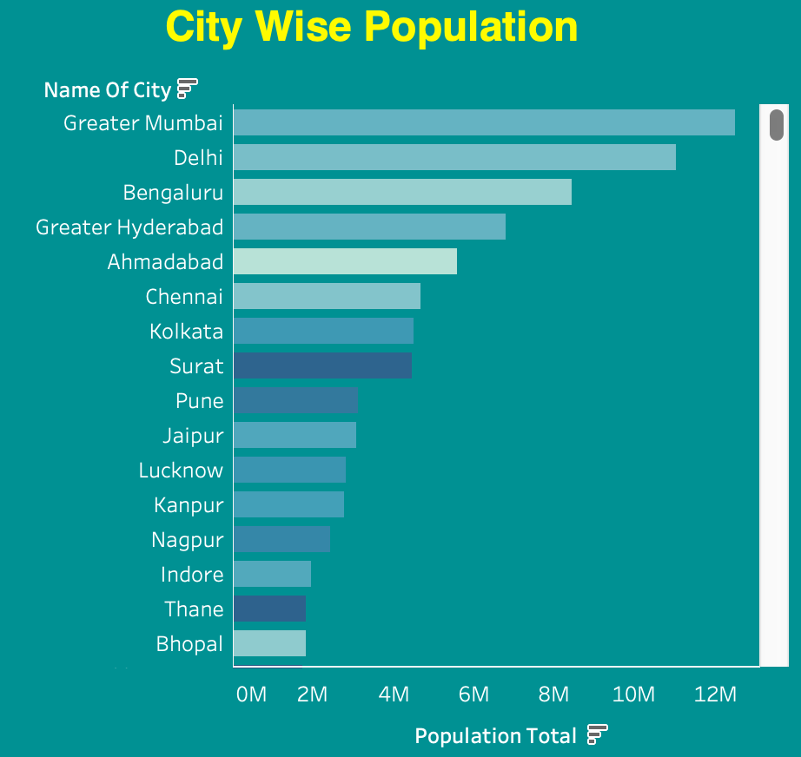
City-wise Population
From this, we can conclude population is higher in tier-I rather than tier-II.

Slide 20
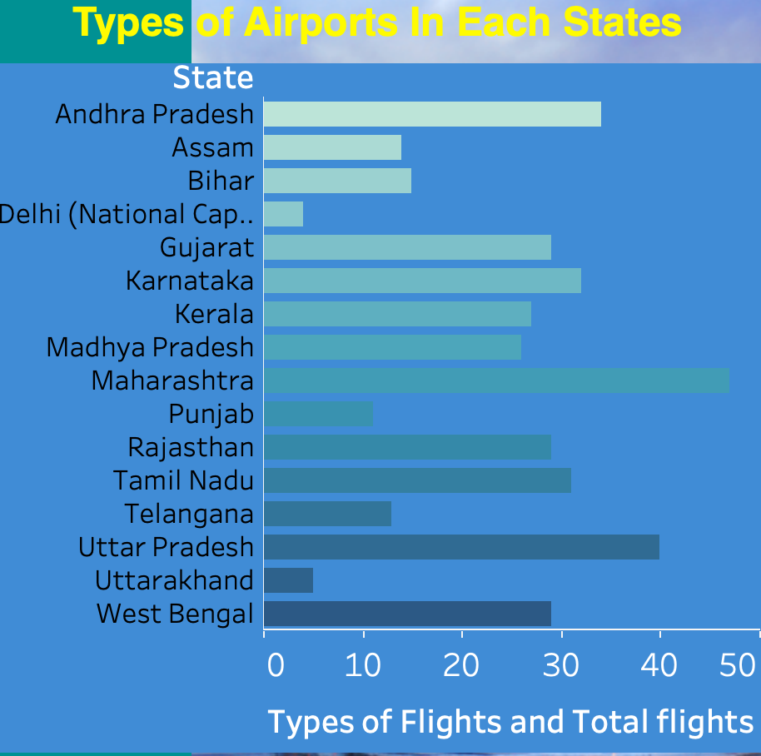
Airports in Individual States
There are many airports in all major and minor cities where we can say, tier-II cities have many airstrips , heliport etc. But unfortunately, many of them are closed and it is kind of evident from our visualization.

Slide 21
Upcoming Airports
These are the some of the Airports are upcoming in INDIA(Tier-II)
Andhra Pradesh Nellore Airport
Arunachal Pradesh Itanagar Airport
Assam Rupsi Airport
Bihar Bihta Airport
Gujarat Dholera Airport
Gujarat Rajkot Greenfield International Airport
Himachal Pradesh Mandi Airport
Jammu and Kashmir Kisthwar Airstrip
Karnataka Karwar Airport
Kerala Thiruvambady Airport

Slide 22
Conclusion

Slide 23
After all the visualization , we can conclude that , tourism, GDP, Airport connectivity, Industries plays a major role in macro-economy.
And People tend to be in comfort zone and look for quick commuting for daily life.
It is very much evident that , people choose the cities which has more industry.
Cities which have very good monuments are helping to attract the international tourist to visit and helps in economic growth.

Slide 24
From all the research and analysis we did, and putting up the problem statement "To improve and identify the new air travel routes" we are concluding that to improve the air travel the government must invest half of its high GDP cites economy to the tier-II cities, this will make the people to travel to those cities and which may lead to more economic gain for each state. And it is also notable that all tier-II cities too have the tourist places to visit but the major drawback is the mode of transport. So, we must look to improve the transportation for easy communication to nearby urbanized cities. We also noted that there is many airports, airstrips, heliports which has been closed and not maintained well. If we are able to re-open it for small airports, use it for the transit purpose and it will automatically lead to new air travel routes.

Slide 25
Upcoming Tier-I Cities
After all the research and analysis these are the upcoming Tier –I cities:
Jaipur
Chandigarh
Vishakhapatnam
Kochin
For Instance:
Taking the population of Jaipur which is 3 billion, soon will above 4 billion and joins the Tier –I cities, and many industries been opened, having an International Airport.

Slide 26
Thank you
Karthik.arunkumar@agilisium.com
Bhagyashree.gohiya@agilisium.com
Udatha.venu@agilisium.com

